Slide 1
Preprocessing & Layout Analysis for Offline Handwriting Recognition
東北大学大学院工学研究科
電子工学専攻川又研究室
Perttu Pitkänen

Slide 2
Overview
Handwriting recognition
Preprocessing
Layout Analysis
Tests
Conclusions
Future work

Slide 3
Handwriting recognition 1
Offline handwriting recognition (HWR) is the process of extracting text in digital form from handwritten images.
Offline recognition process can be divided into three main phases:
Preprocessing
Feature extraction
Classification
Implementation done with MATLAB and its image processing toolbox

Slide 4
Handwriting recognition 2
Preprocessing
Image is enhanced for feature extraction phase and the detected characters are segmented from the original image.
Layout analysis can be considered to be a part of preprocessing
Feature Extraction
Shape describing features are extracted from previously acquired objects.
Classification
Extracted features are used in machine learning algorithms to create the feature vector.

Slide 5
Preprocessing 1
Most of the preprocessing is same than previously
Image aquisition
Noise removal
Adaptive Wiener filter
Binarization
Sauvola algorithm
Object property analysis
Features such as holes in object, size, area or aspect ratio
Stroke width variation
Object property analysis now uses sroke width instead of other features.

Slide 6
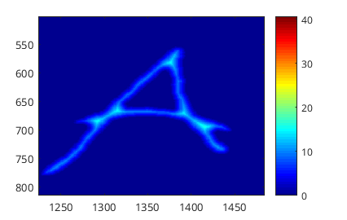
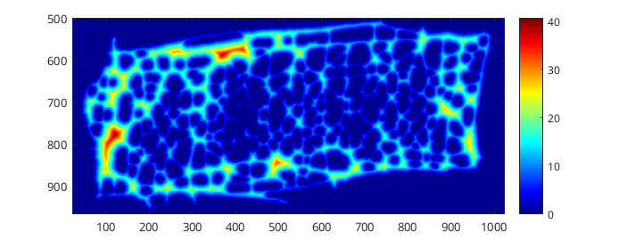
Stroke Width Analysis 1
One distinctive feature of text is that it consists of ”strokes”
Strokes have only a little variation in thickness.
Other objects such as images can have lot of variation in thickness.
The amount of variation can be used to distinquish text from other objects.
Dark blue represents thin stroke width and dark red thick strokes

Slide 7

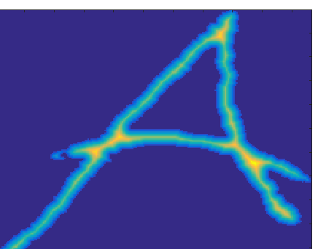
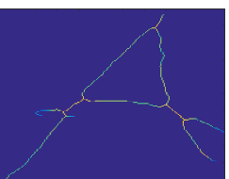
Stroke Width Analysis 2
Get image regions
Distance transform
For each pixel find distance to nearest black pixel
Get image skeleton
Make one dimensional vector V which contains all distance transform values
[6.403, 8.5440, 6.4031, 8.0623, 5.6569, 7.2801,...]
Calculating stroke width metric to represent the width variation.
Standard deviation of V divided by the mean value of V.
0.2360
Removing values that have more variation than threshold

Slide 8
Tests
fasdf

Slide 9
Test results
dfdfasdfasdf

Slide 10
Future work
öäöå

Slide 11
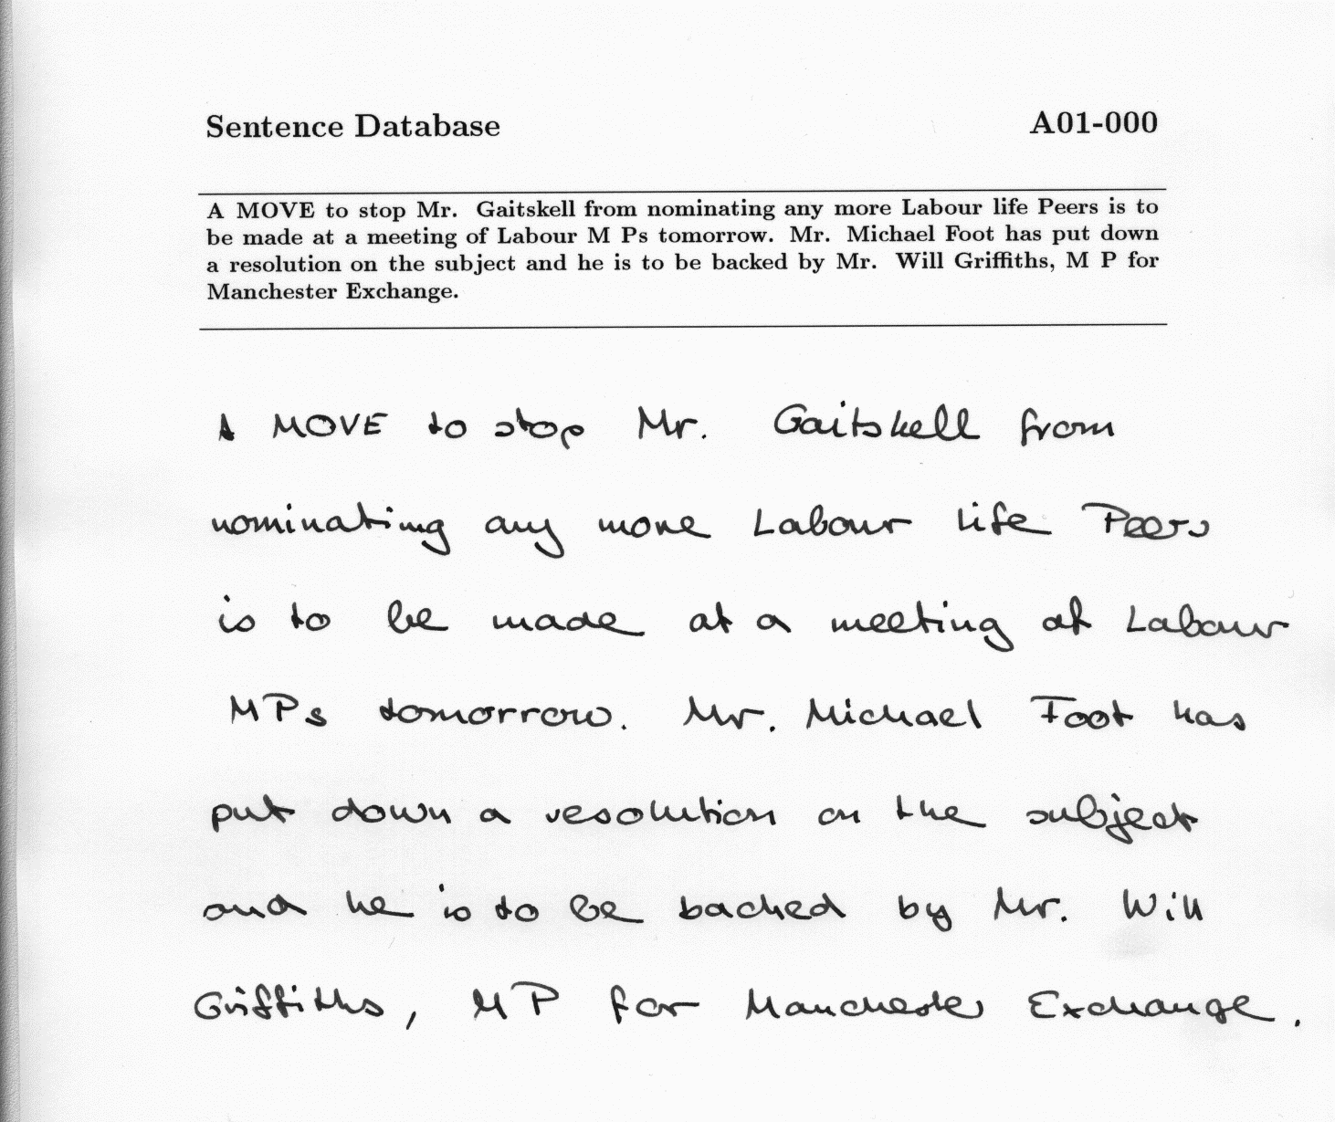
Example entry in IAM handwriting database.

Slide 12
Questions and Answers 1
Presentation time:
Presentation: 16:36
Questions: 20:04
Okubo : What is the meaning of the hole of the object?
In binary image hole is black area (zeros) which is completely surrounded by white pixels (ones). For example ideally the letter O should have one hole. In some cases binary images have many small holes due to noise.
Okubo: The character "E". You could detect it in some case and in other case not. What is the difference between that?
In slide 23 the two character “E”s have different amount of tiny holes in them. Objects with number of holes is removed and the other letter E has too many small holes.
Sone: What is the meaning of the red pixel? p.13
Red boxes are drawn around detected regions. In the image there is over 22 000 objects. Many of them look like just random red pixels.

Slide 13
Questions and Answers 2
Sone: Too much text. Please show both of the picture before and after filtered if you compare them.
I will try to remember these suggestions in next presentation.
Konta : How did you determine the coefficient of the Wiener filter? p. 8
The filter size was chosen with going through many filter sizes from 3x3 to 20x20 and choosing the value which didn’t break the characters and at the same time removed most of the noise. The comparison was made visually and the number of objects was monitored at the same time.
Konta : The result seems to be better if the size of the Wiener filter is 20 than 6. How do you think about this?
The Wiener filter size 20 actually breaks the characters and we lose information. Closer inspection of image at p.19 shows that the numbers from 0 to 3 are broken beyond recognition. Although during the presentation it might not be obvious.

Slide 14
Questions and Answers 3
Konta : The intensity of the red and blue is different when you convert the picture to gray scale. Don’t you use the color information?
Many of the binarization algorithms including Sauvola-algorithm work with grayscale images. It was good observation that some text information can be lost if the image is changed straight to grayscale. More research should be put into this problem.
Sone : What camera did you use? This experiment is affected from the spec of the camera. (ex. resolution) You can use better camera in the laboratory. Please use it.
I used my smartphones inbuilt camera. The motivation of the project was to provide digitization system for photographs of handwritten notes. In real life situation these photographs are often taken with smartphone cameras. The resolution affects the preprocessing and it is important to keep it as constant. I will consider better camera or scanner for further testing.

Slide 15
Questions and Answers 4
Tanaka: The characters is separated in the picture. In general, there are some cases that characters are not separated. How do you process in such a case?
At this point this problem wasn’t yet addressed. Especially cursive handwriting includes connected characters. The found objects can be analyzed, split up and then analyzed again to see if the results are better or worse. The split can be done in the most thin part. Also some characters can be broken because of thin strokes. These characters can be connected in a similar manner.
Tanaka: The characters are vertical to the picture. How do you do if the characters are diagonally?
This system doesn’t yet take the text orientation into account. This is another problem that has to be handled during the development process.

Slide 16
Questions and Answers 5
Abe: In this case, you are considering about the color of the pen. Do you think there will be some other problems if the color of the paper is changed?
The color of the paper can affect the results. Although I didn’t test it at this point I think that the Sauvola-algorithm can handle the different colors well.
Kawamata : What is Sauvola-argorithm? p.11
Sauvola algorithm is binarization algorithm which calculates the new threshold for given pixel. The algorithm needs two parameters window size and parameter k called “sensitivity”. The algorithm can adapt to different intensities caused by effects such as shadows or gloss.
Kawamata : Who is Sauvola? p.11
Sauvola is image processing researcher from Oulu University Finland. The algorithm was developed in year 2000.

Slide 17
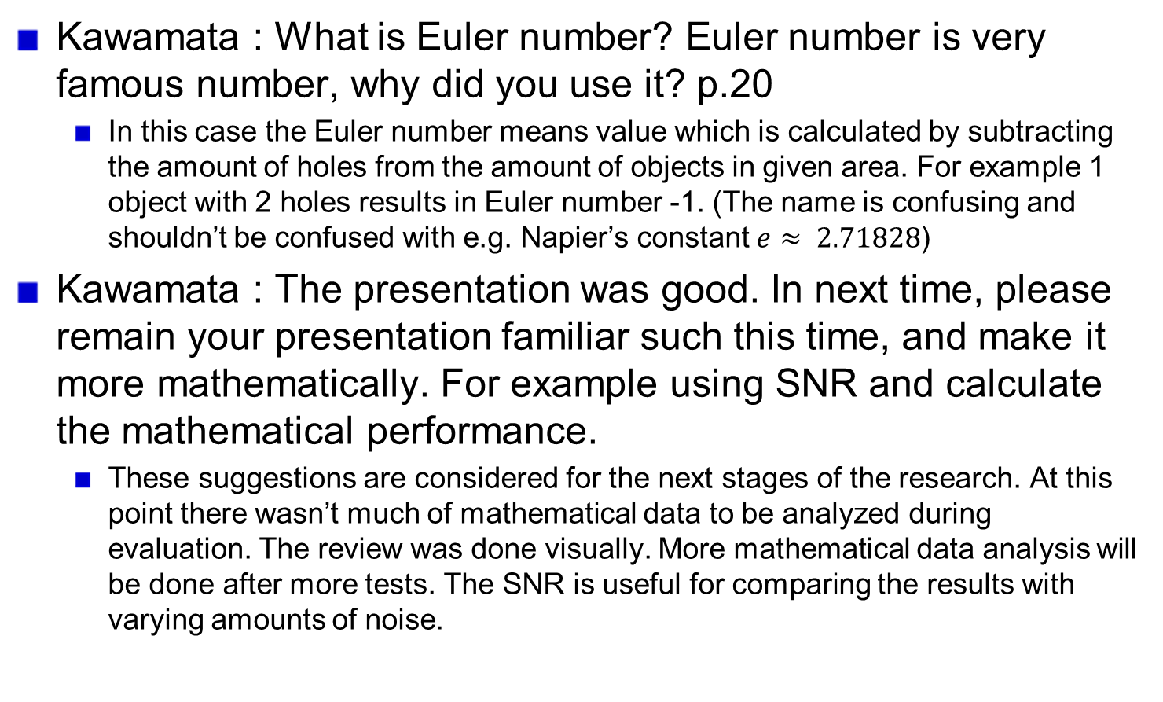
Questions and Answers 6
Kawamata : What is Euler number? Euler number is very famous number, why did you use it? p.20
In this case the Euler number means value which is calculated by subtracting the amount of holes from the amount of objects in given area. For example 1 object with 2 holes results in Euler number -1. (The name is confusing and shouldn’t be confused with e.g. Napier’s constant $e≈ 2.71828$)
Kawamata : The presentation was good. In next time, please remain your presentation familiar such this time, and make it more mathematically. For example using SNR and calculate the mathematical performance.
These suggestions are considered for the next stages of the research. At this point there wasn’t much of mathematical data to be analyzed during evaluation. The review was done visually. More mathematical data analysis will be done after more tests. The SNR is useful for comparing the results with varying amounts of noise.

